Slide 1
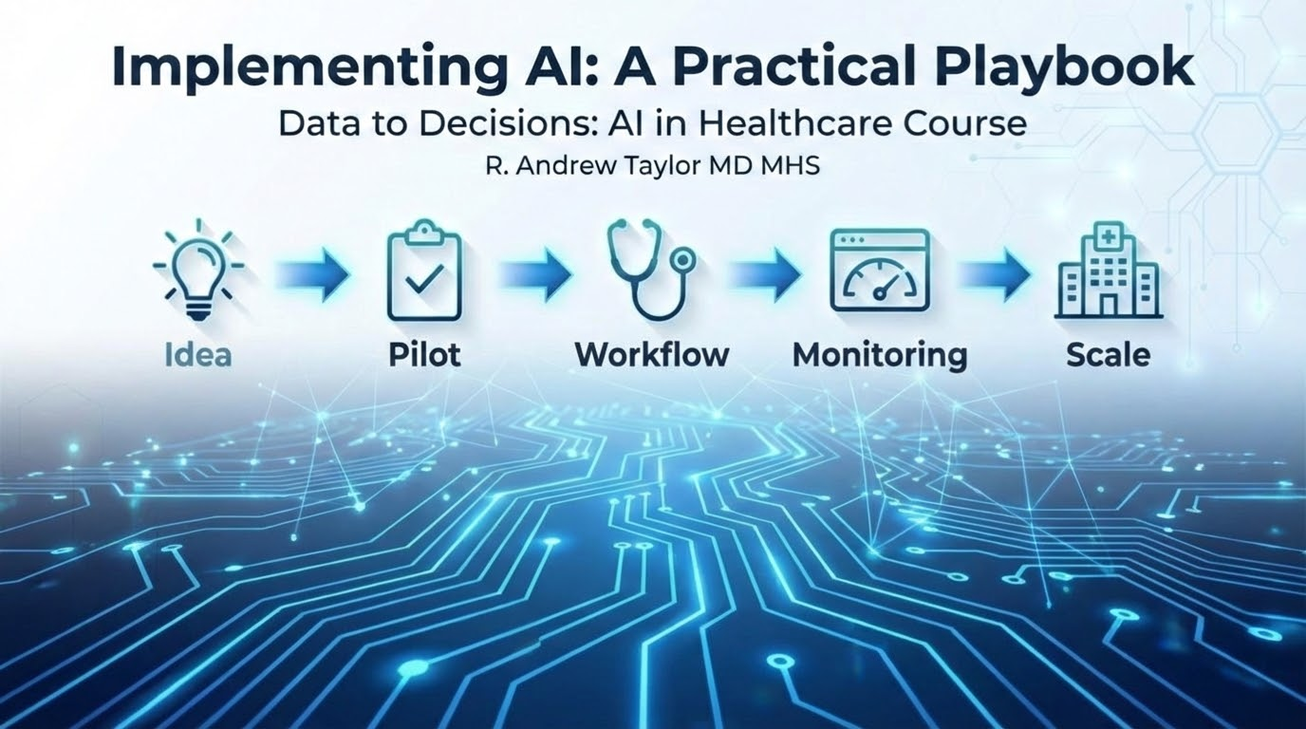

Slide 2
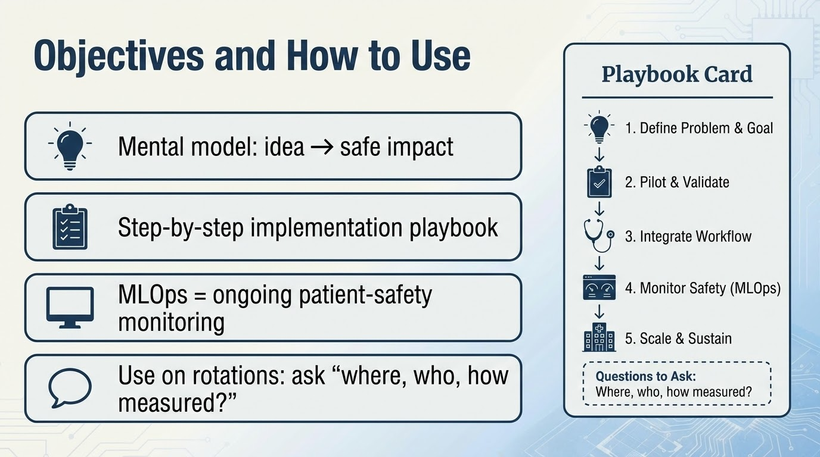

Slide 3


Slide 4
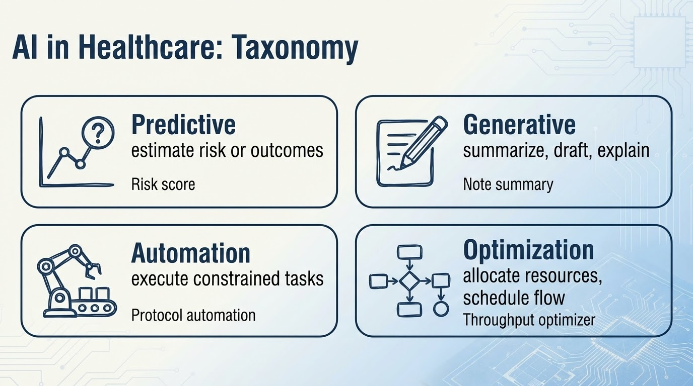

Slide 5
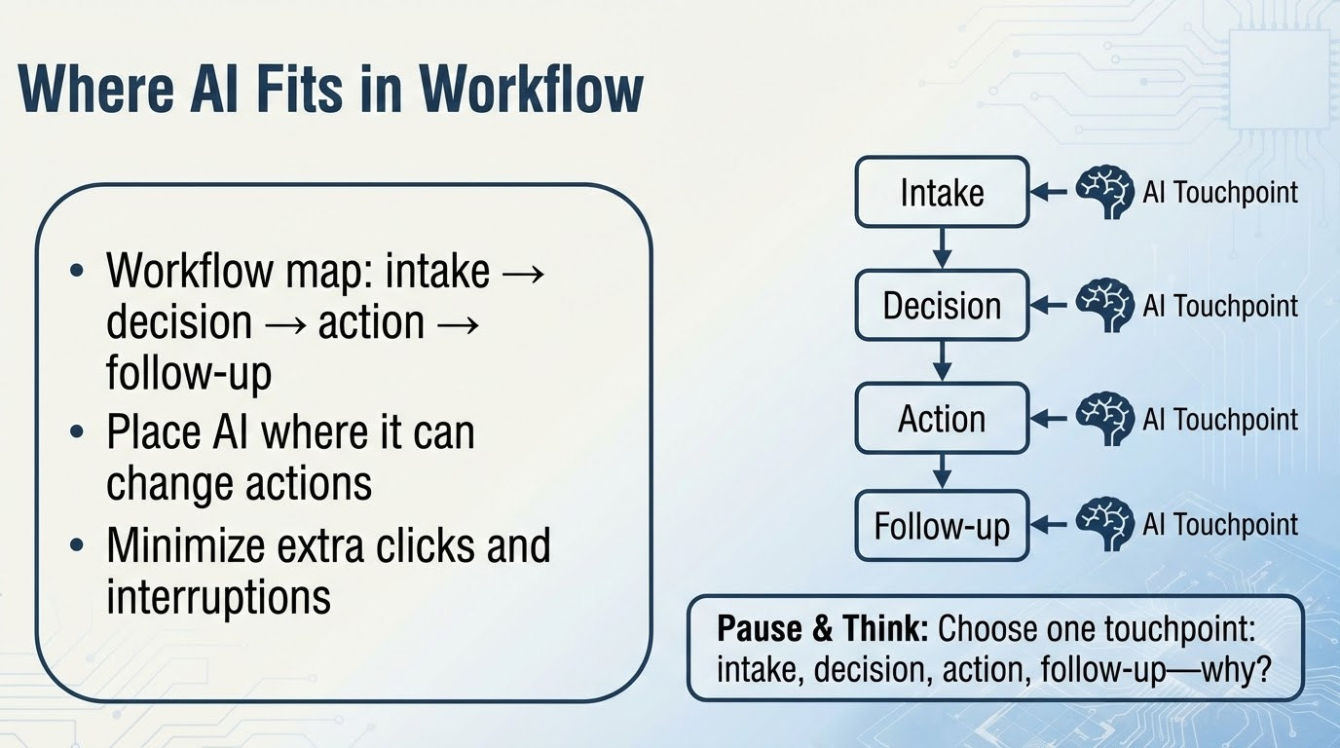
Notes:
Teach: AI value requires a “decision + action + owner”
Common error: predicting risk with no operational pathway
Answer guidance (for the pause):
Intake: great for triage/queueing; risk is over-alerting early data
Decision: supports ordering/diagnosis; risk is over-reliance
Action: automates steps; risk is unsafe automation
Follow-up: chronic disease; risk is equity/access gaps

Slide 6
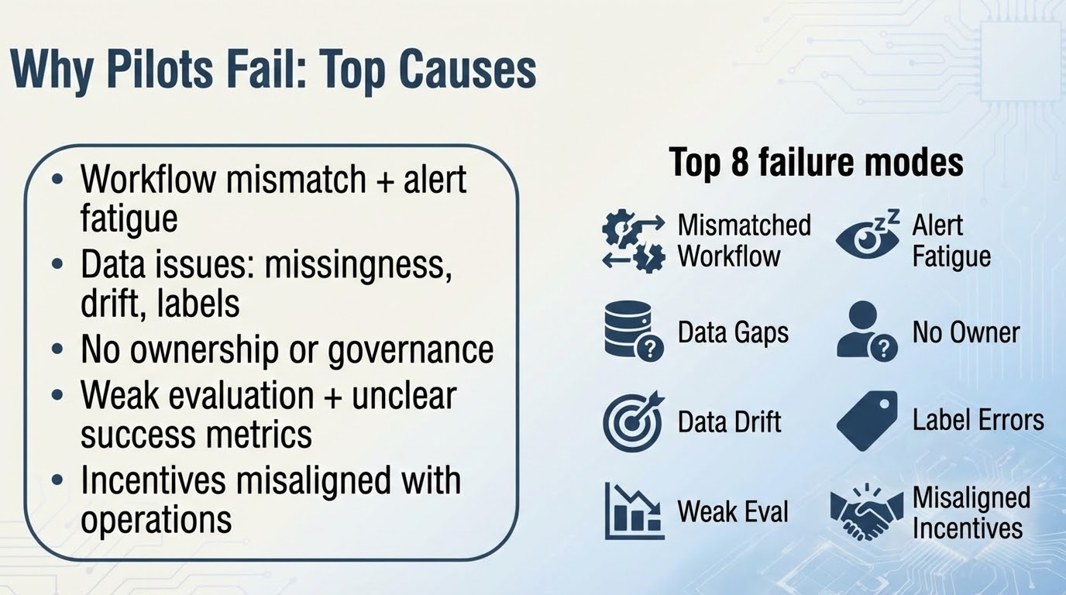
Notes:
Walk through the “failure mode mindset”: pre-mortem before build
Highlight alert fatigue as a predictable, measurable failure
Drift: the model may be “right at launch” and wrong later
Ownership: if no clinical owner, nobody is accountable for harms/updates
Example: operations/crowding predictor that doesn’t integrate with bed management actions becomes a dashboard nobody uses
Example: triage tool deployed without nursing co-design creates workarounds and distrust 1 takeaway line: Most AI failures are predictable implementation failures.

Slide 7
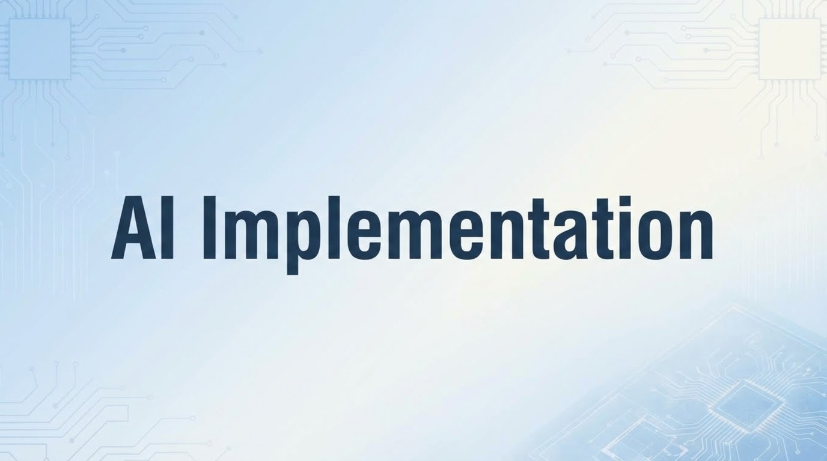

Slide 8
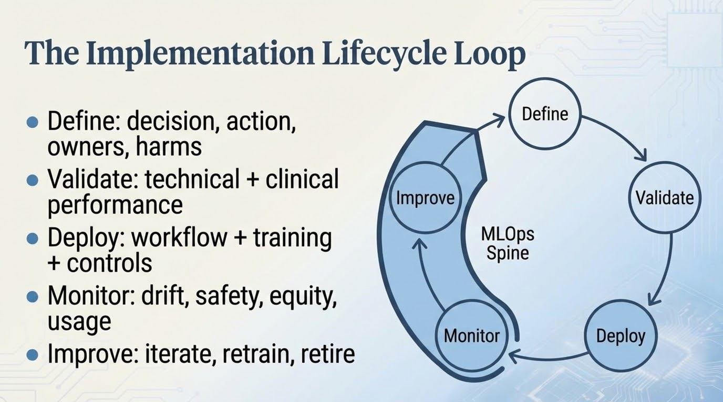

Slide 9
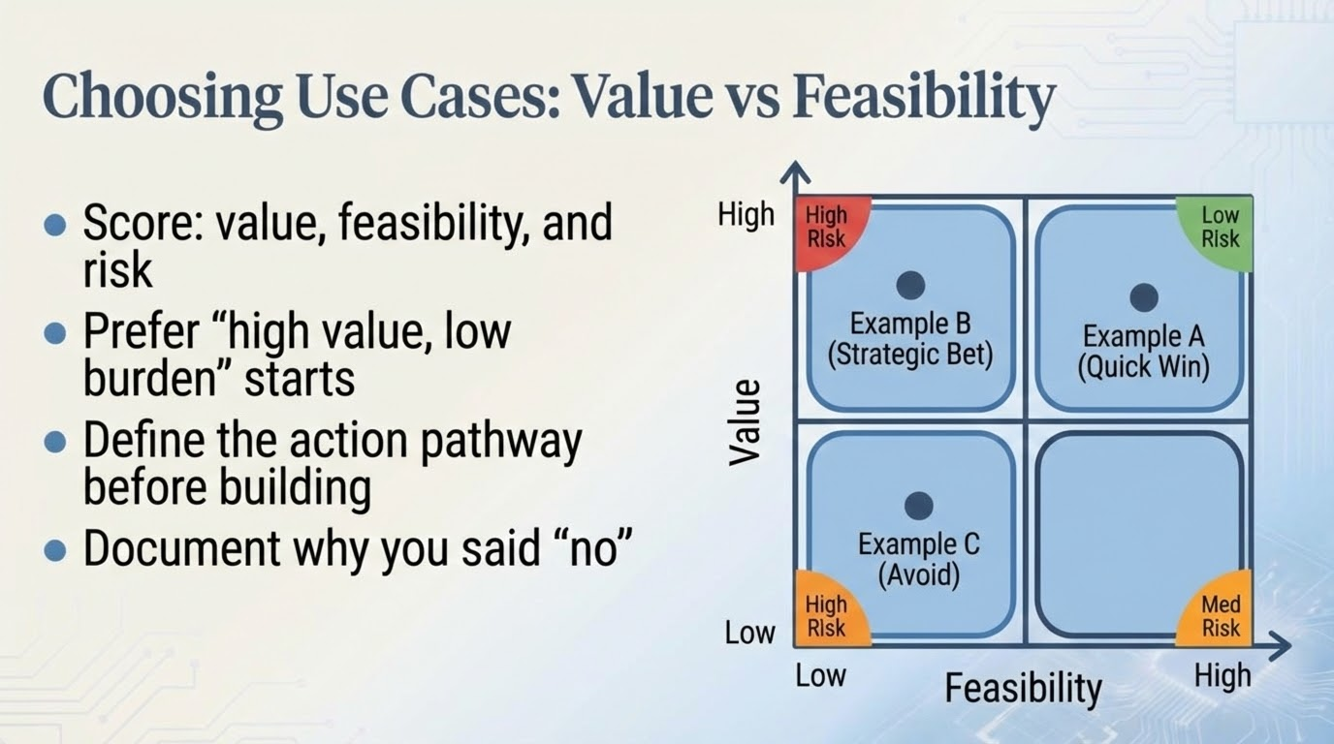

Slide 10
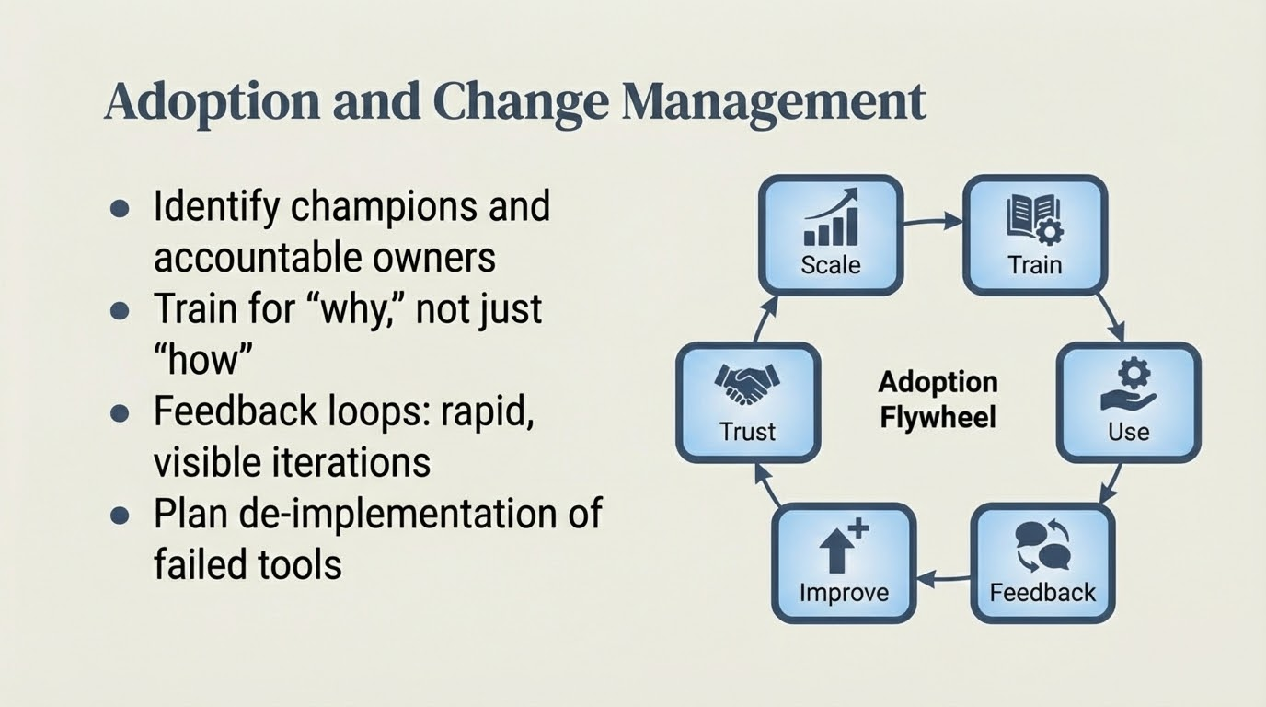
Notes:
Adoption is a clinical behavior change intervention
Champions must be empowered, not symbolic
Show early wins and transparently share problems/fixes
De-implementation is success when the tool doesn’t work
Example: triage tool adoption improves when nurses see weekly metrics and changes based on their feedback
Example: LLM summarizer adoption improves when edits are captured to refine prompts and reduce errors 1 takeaway line: Adoption is built through trust, feedback, and visible improvement.

Slide 11
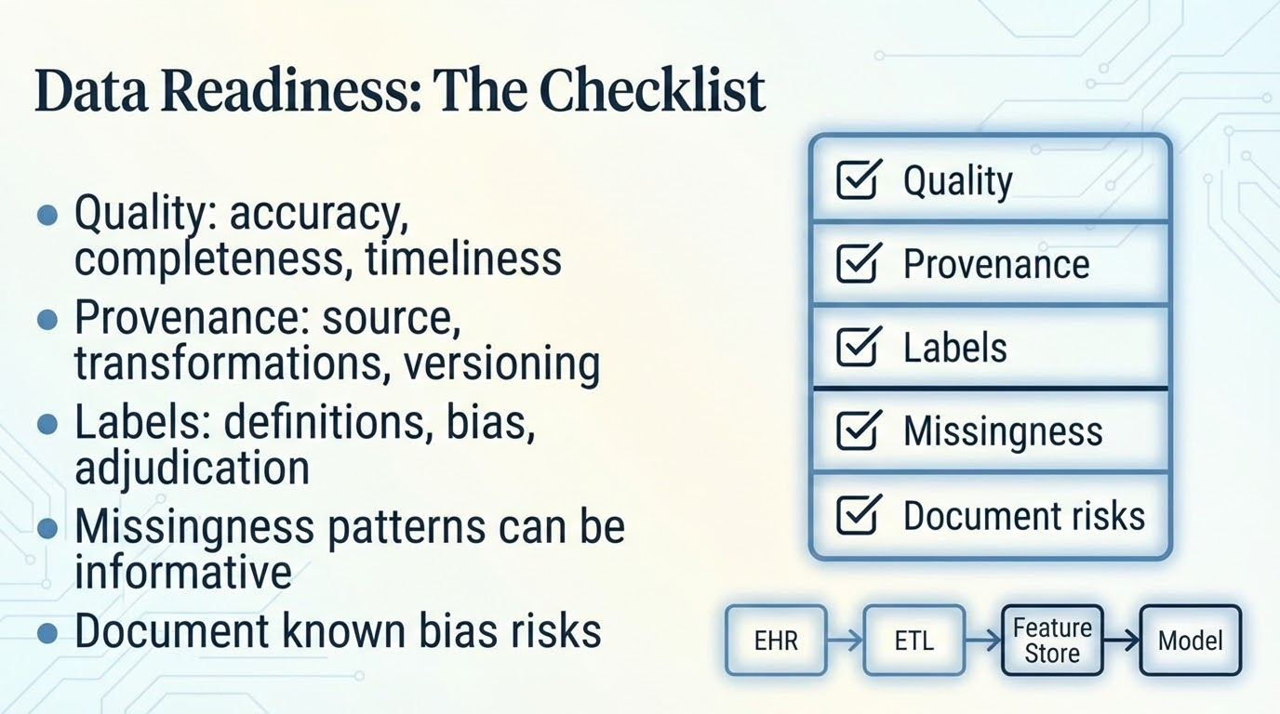

Slide 12
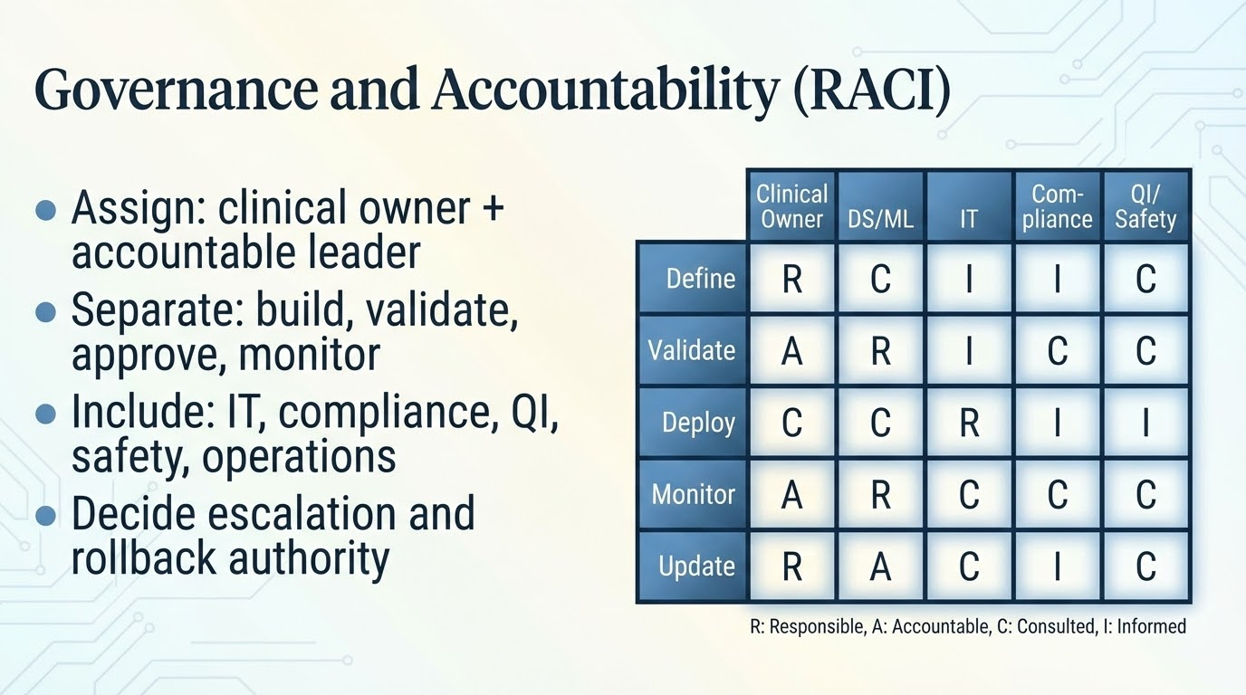
Notes:
Teach “ownership prevents orphaned models”
Clinical owner defines success, failure, and acceptable tradeoffs
IT owns reliability; DS owns model performance; Safety owns harm monitoring
Compliance clarifies documentation and regulatory posture
Example: inpatient deterioration model—rapid rollback authority must be explicit
Example: ambient note summarization—privacy and PHI handling must be owned 1 takeaway line: If nobody owns the model, nobody protects patients.

Slide 13
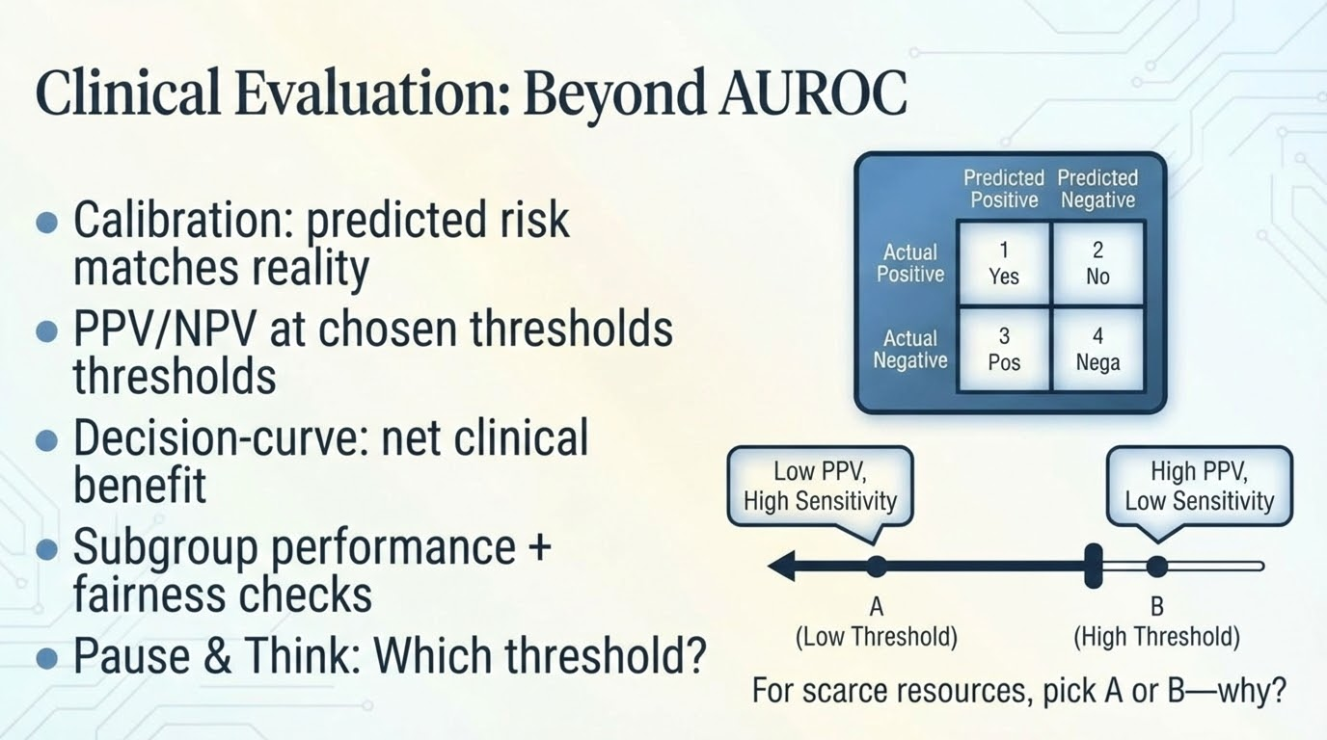
Notes:
Explain why AUROC can hide operational failure
Calibration matters when decisions depend on risk levels
PPV depends on prevalence; students must internalize base rates
Answer guidance (pause):
If scarce resource (e.g., ICU bed), higher PPV may be preferred
If high-stakes miss (e.g., stroke), accept lower PPV to reduce false negatives, but plan workload
Vignette (radiology/imaging assist): pulmonary embolism assist—evaluate PPV at “CTA ordering threshold,” monitor missed PE rate and downstream imaging utilization
Mention decision-curve: align threshold with clinical utility, not just statistics 1 takeaway line: “Good” means clinically useful, calibrated, and equitable.

Slide 14
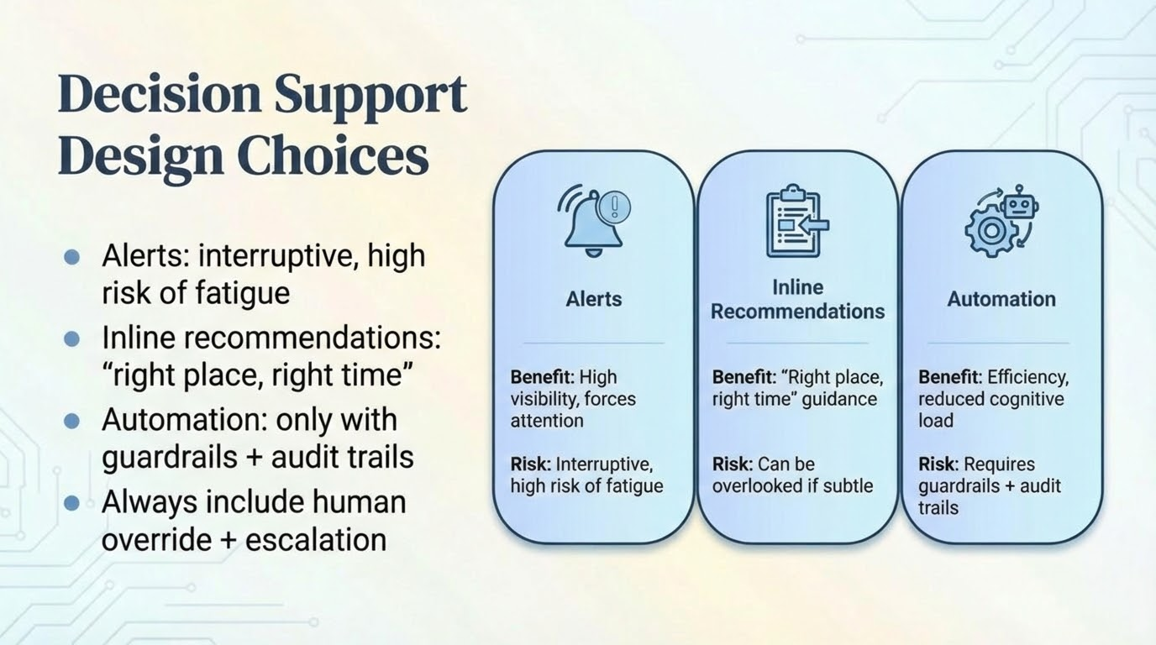

Slide 15
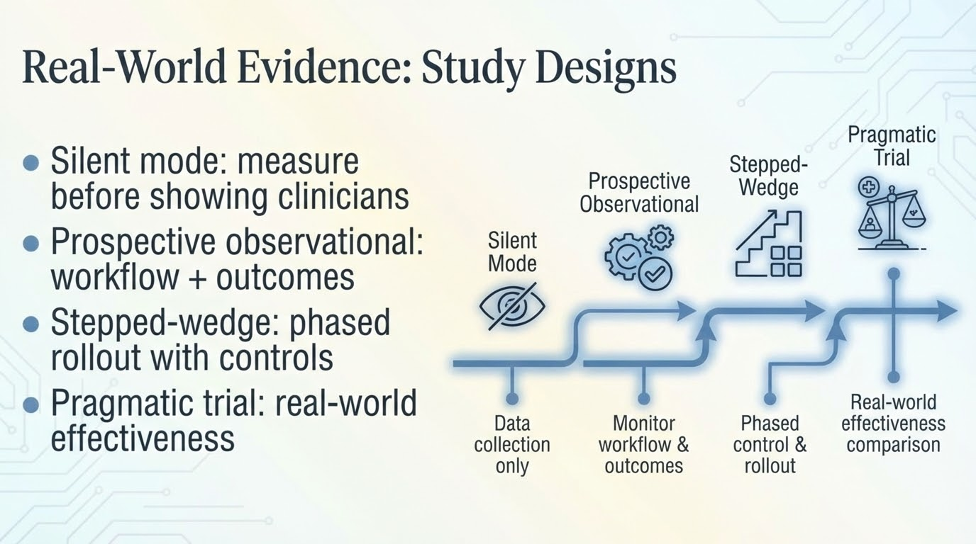

Slide 16
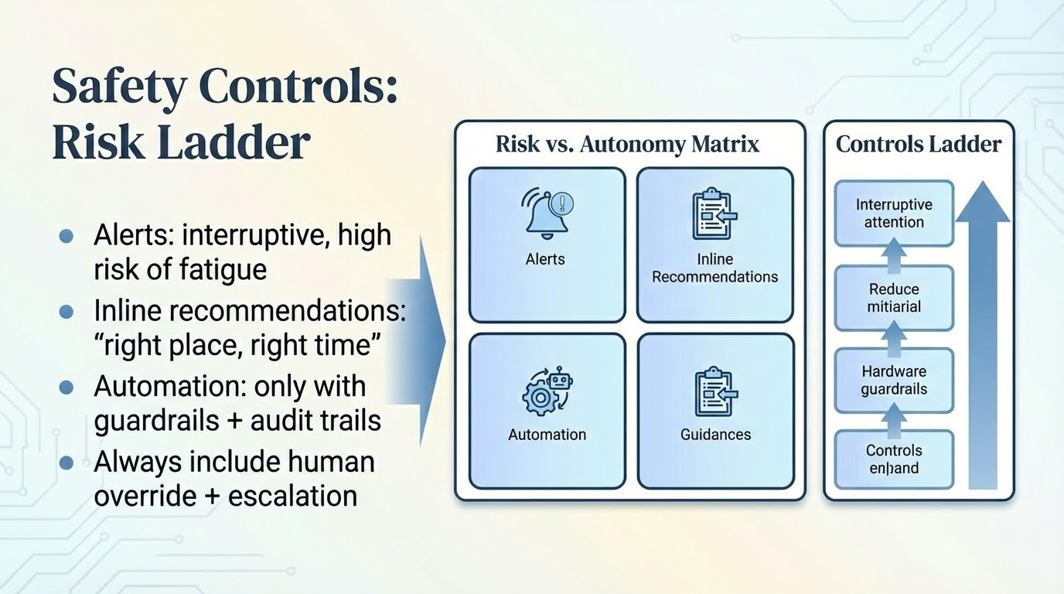
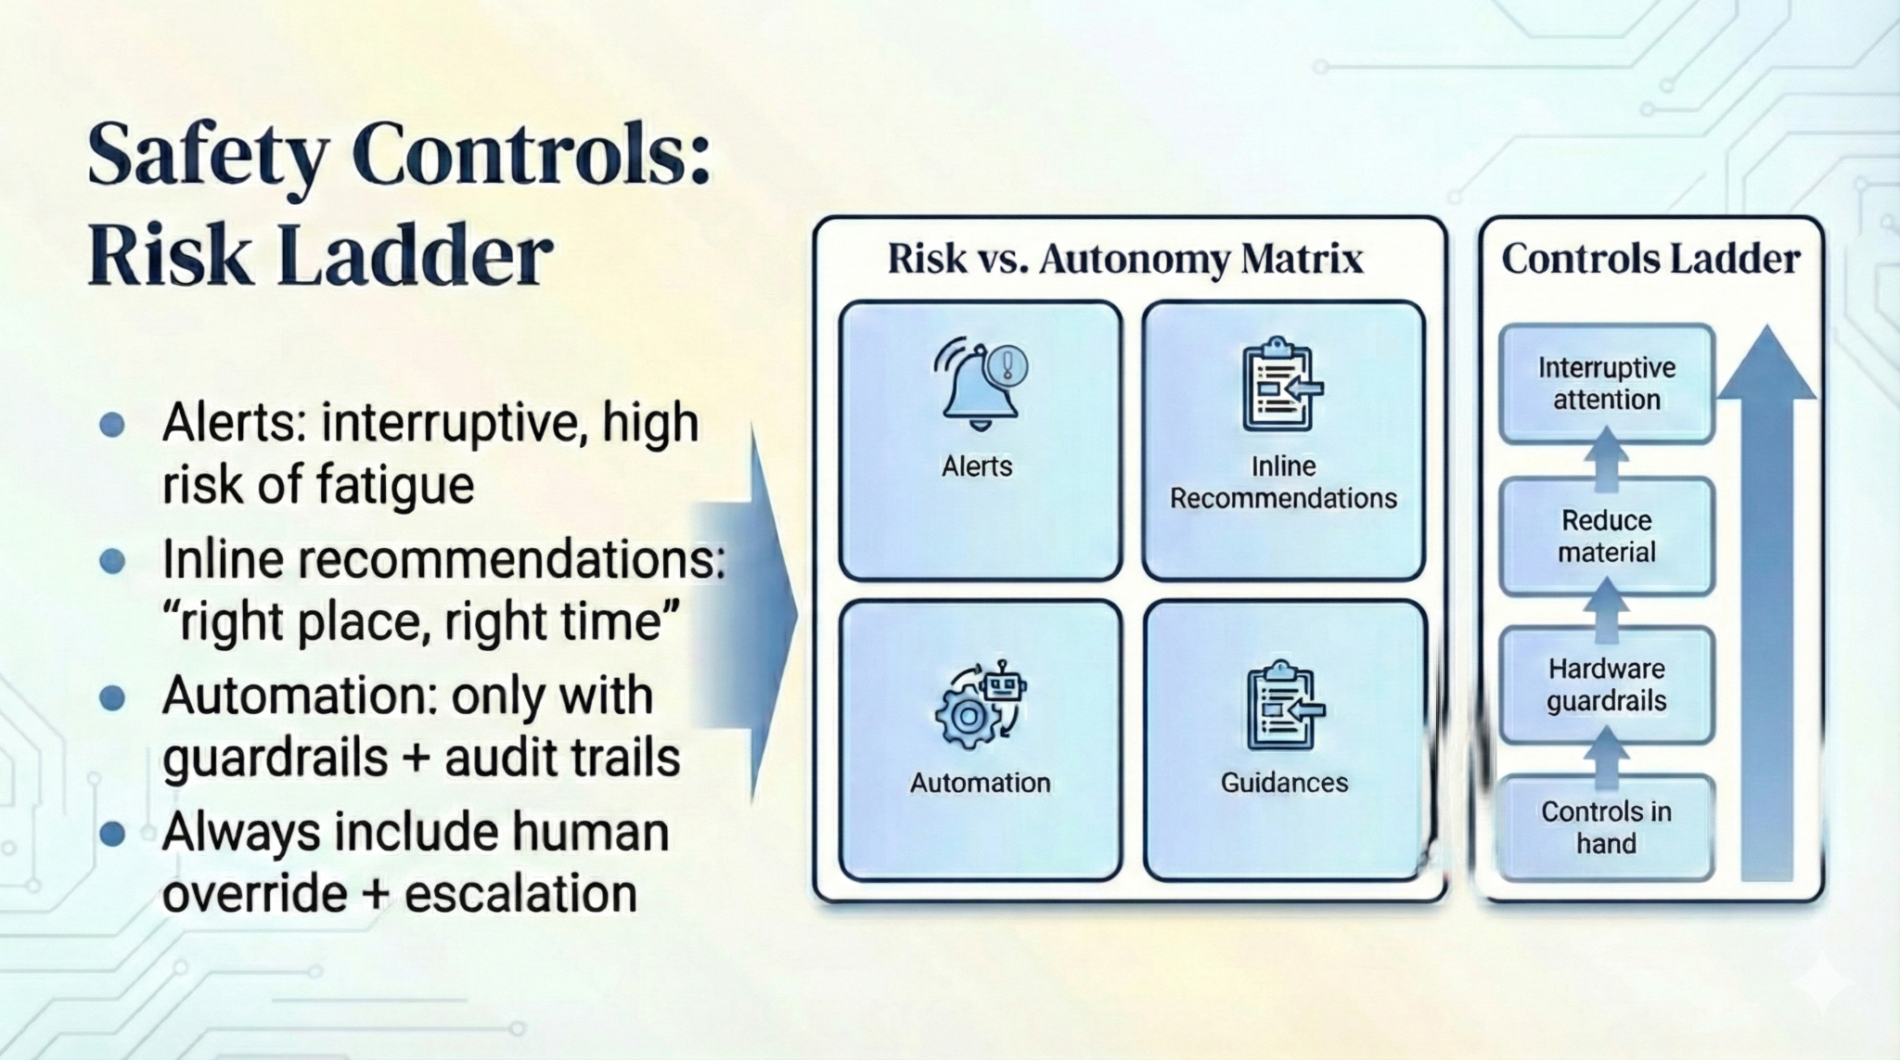
Notes:
Explain “risk tier” determines evidence burden and controls
High-risk domains need stronger validation and tighter change control
Audit logs: who saw what, when, and what they did
Fallback is essential: if AI down, clinical care must remain safe
Example: radiology assist is typically “recommend,” not “automate”
Example: low-risk automation might be routing routine messages with review 1 takeaway line: Safety controls should scale with risk and autonomy.

Slide 17
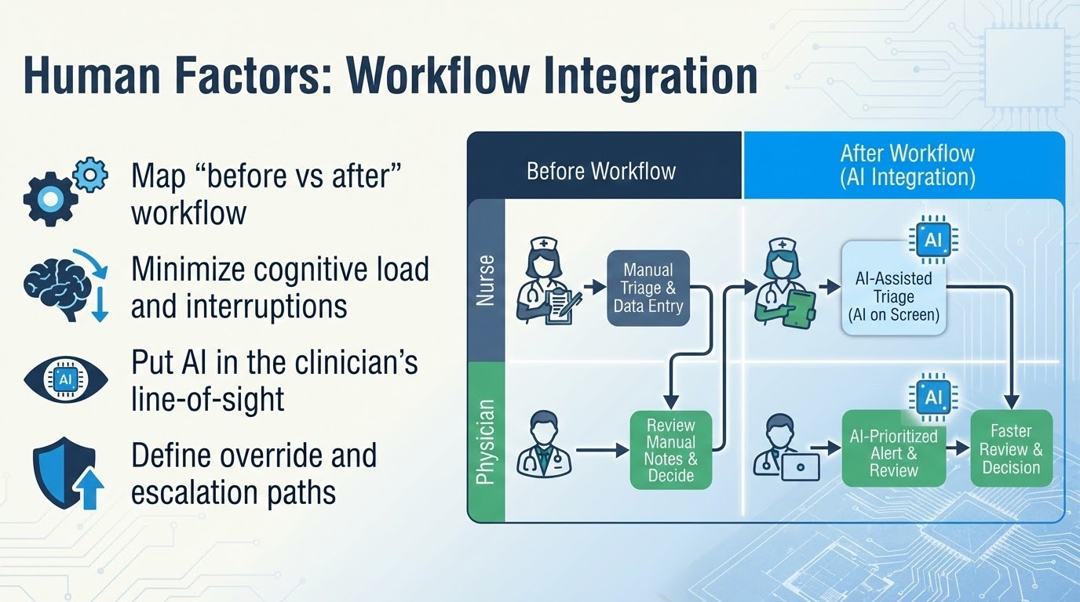

Slide 18
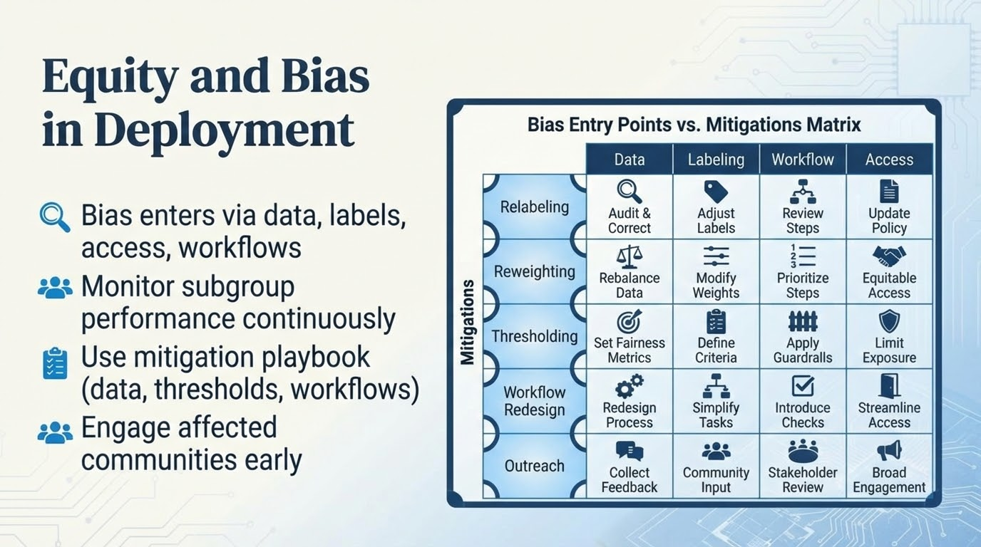

Slide 19
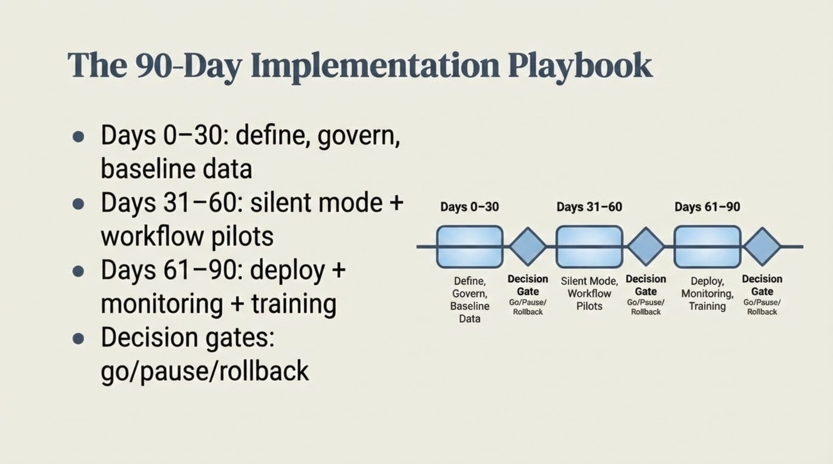
Notes:
Make this the “doable” blueprint students can remember
Day 0–30 deliverables: use-case spec, RACI, data readiness, risk tier, success metrics
Day 31–60: silent mode results, human factors testing, threshold policy draft
Day 61–90: training plan, monitoring dashboard live, incident response rehearsed
Decision gates prevent sunk-cost fallacy
Example: if silent mode shows unmanageable alert volume, pause and redesign before go-live
Example: if subgroup performance gap is found, mitigate before deployment 1 takeaway line: A time-boxed playbook turns AI into an executable plan.

Slide 20
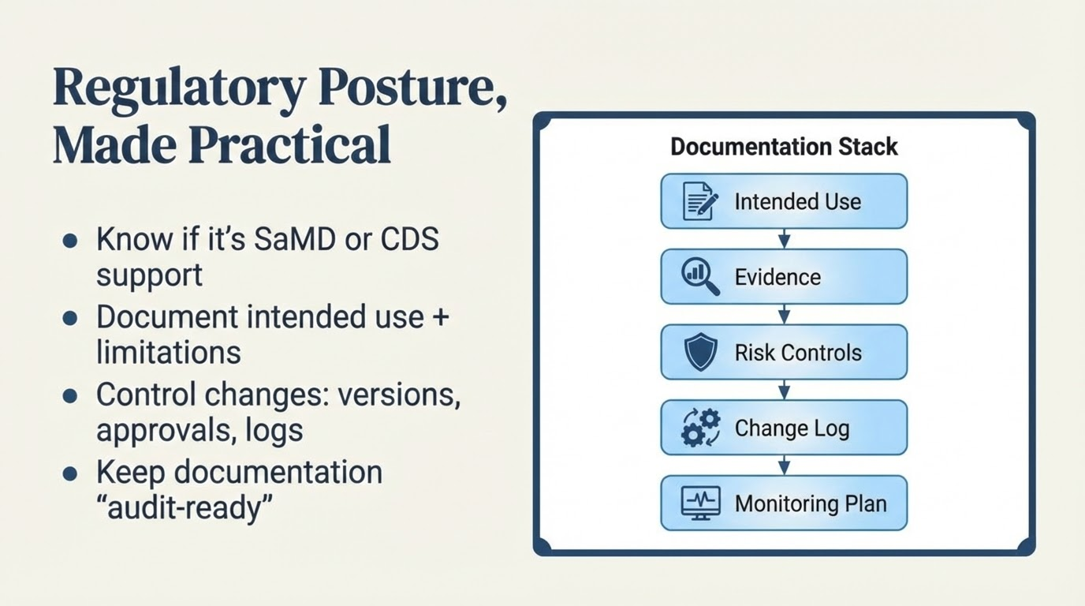

Notes:
Keep this accessible: students need the posture, not legal details
Explain: regulatory intensity rises with autonomy and harm potential
Emphasize “change control” as the operational heart of regulation
Mention that frameworks differ by country, but principles are stable: intended use, evidence, risk controls, traceability
Example: radiology tool marketed as diagnostic vs assist—changes oversight requirements
Example: internally built CDS still needs documentation for safety and governance 1 takeaway line: If you can’t document it, you can’t defend it.

Slide 21
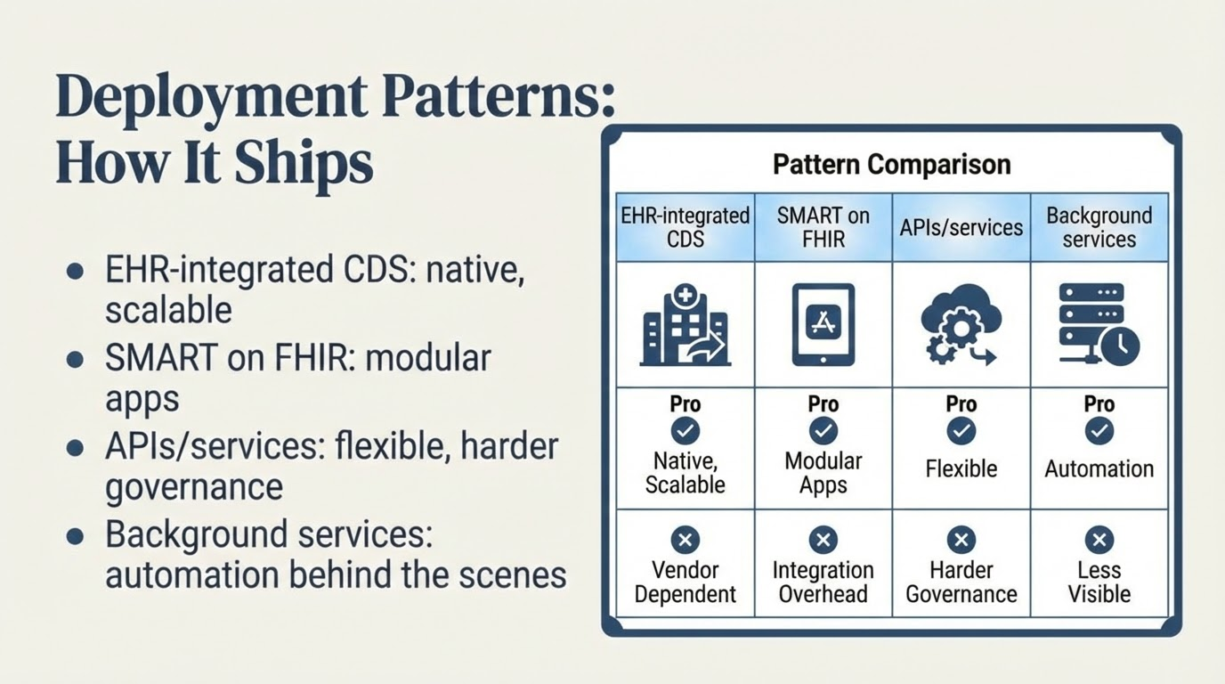
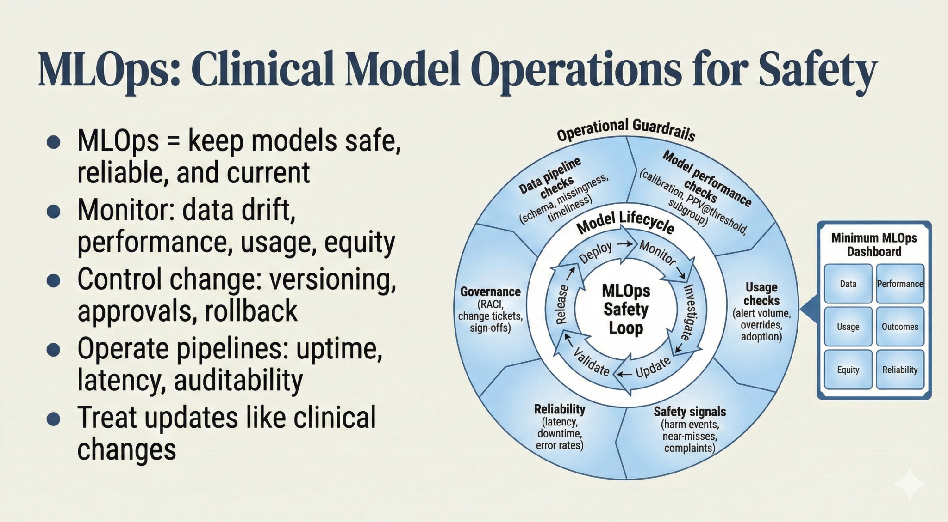
Notes:
EHR-native: best for adoption, but slower change cycles
SMART on FHIR: good for rapid iteration and portability; needs strong identity/security
APIs: flexible; risk of fragmentation and unclear ownership
Background services: powerful; needs strong audit trails and rollback
Example: inpatient deterioration model as background service feeding a rounding list
Example: outpatient risk stratification via API feeding care management workqueues 1 takeaway line: Deployment choice determines adoption, governance, and safety.

Slide 22
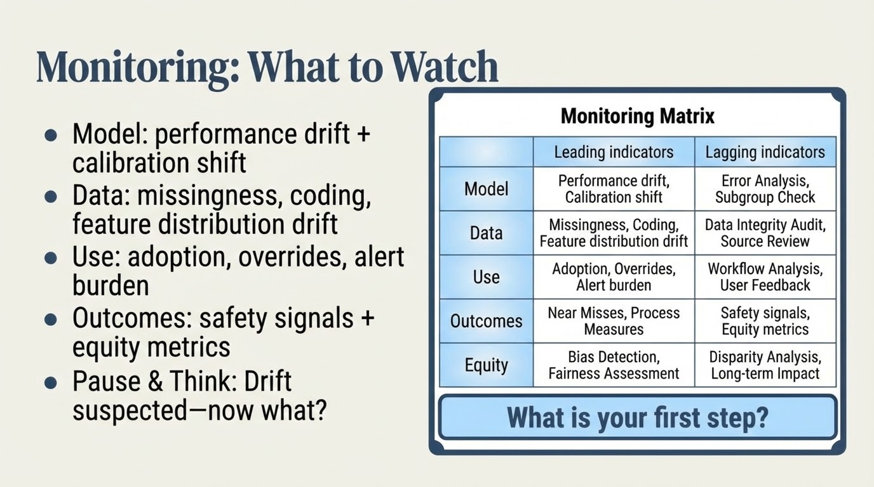
Notes:
Teach “leading vs lagging” indicators (usage drops precede outcome drift)
Answer guidance (pause):
Step 1: verify data pipeline integrity (missingness/format changes)
Step 2: assess recent workflow/EHR changes and population shift
Step 3: activate incident workflow: severity, scope, temporary safeguards
Step 4: consider rollback or threshold adjustment while investigating
Vignette (inpatient deterioration/monitoring): wearable vitals model shows rising false alarms after new device firmware; first investigate data drift, then adjust filters, then revalidate and communicate changes
Emphasize equity: subgroup monitoring is part of routine monitoring, not optional 1 takeaway line: Monitoring is the early warning system for patient safety.

Slide 23
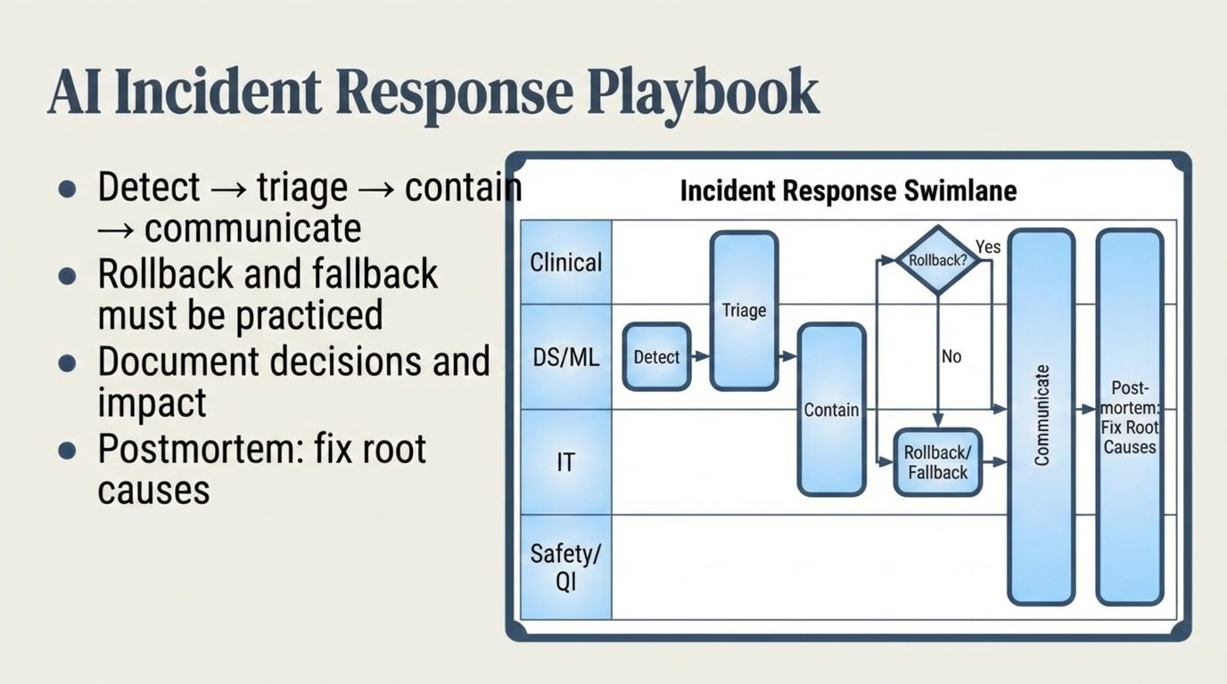
Notes:
Normalize that AI incidents will happen; plan beats panic
Detection sources: dashboards, clinician reports, safety events
Triage: severity (harm potential), scope, and time sensitivity
Contain: disable alert, raise threshold, route to manual review
Communication: frontline message + leadership + documentation
Example: sudden spike in false positives after EHR upgrade → disable feature feed and rollback model
Example: LLM summarizer hallucination cluster → restrict to low-risk sections pending review 1 takeaway line: A rollback plan is a safety requirement, not a luxury.

Slide 24
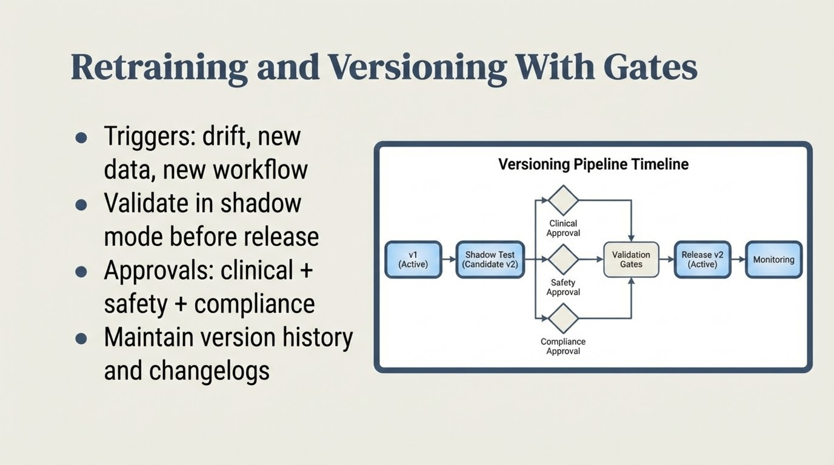
Notes:
Teach “retraining is change management,” not a technical refresh
Shadow testing reduces risk and surprises
Approval gates should be proportional to risk tier
Keep “model cards” and “change logs” simple but complete
Example: new lab assay changes distribution → retrain with validation and recalibration
Example: new triage policy changes labels → update labels and revalidate fairness metrics 1 takeaway line: Every model update is a clinical change that needs controls.

Slide 25
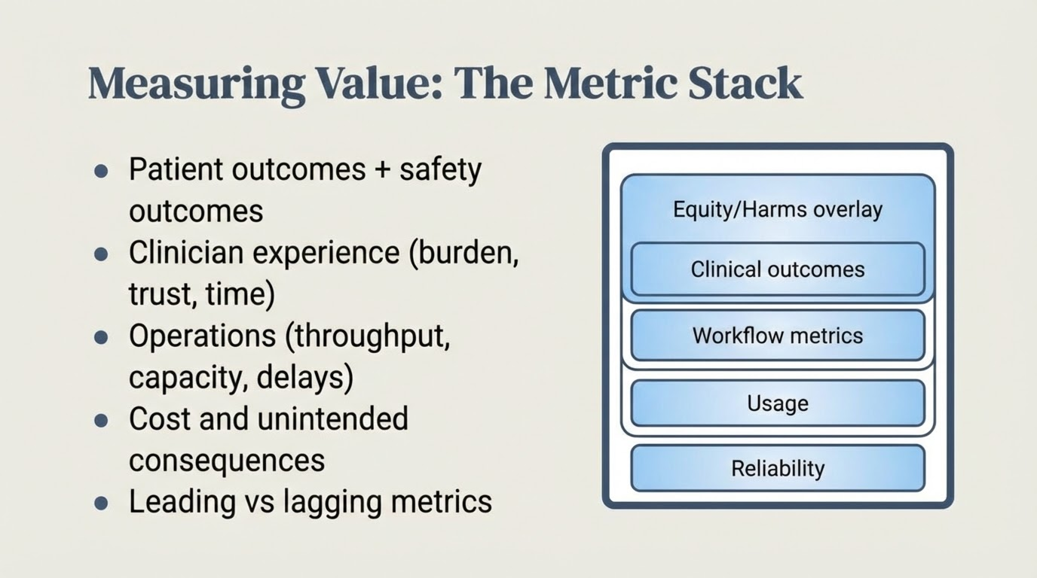
Notes:
Teach: value is multi-dimensional; pick a small metric set per layer
Reliability and usage come first—if they fail, outcomes won’t move
Watch for unintended consequences (extra testing, delays, workload shifts)
Vignette (operations capacity/crowding): ED crowding predictor informs surge staffing + bed huddles; evaluate length-of-stay, left-without-being-seen, boarding time; monitor for gaming and inequitable delays
Example: outpatient tool increases nurse calls—measure workload and burnout risk 1 takeaway line: Measure value across reliability, usage, workflow, outcomes, and equity.

Slide 26
